Slide 1
Analysis and Forecasting of Household Electric Power Consumption (A Group 6 Project)
Gauthami Hanamakonda
Pooja Jhuria
Riya Choudhury
Tarun Sai Babu Polavarapu
Usha Sree Dindi
1

Slide 2
AGENDA
Objective and Importance
Data Preprocessing
Time Series Decomposition
Modelling Approach
Model Comparison and Accuracy
Model Selection
Insights and Recommendations

Slide 3
OBJECTIVE AND IMPORTANCE
To develop robust predictive models for household energy demand, with a particular emphasis on the global active power variable, utilizing the "Household Electric Power Consumption" dataset from the UCI Machine Learning repository. This analysis aims to provide businesses with actionable insights to optimize operations, drive innovation, and implement sustainable energy management strategies.
Efficiency and Cost Optimization: Identifying key factors to enhance efficiency and reduce consumption, leading to cost savings and improved performance.
Resource Planning: Understanding consumer patterns for optimal resource allocation and reliable energy delivery.
Sustainable Practices: Developing interventions for sustainable practices and reduced environmental impact.
Consumer Empowerment: Empowering consumer decisions on conservation and cost savings through educational initiatives.

Slide 4
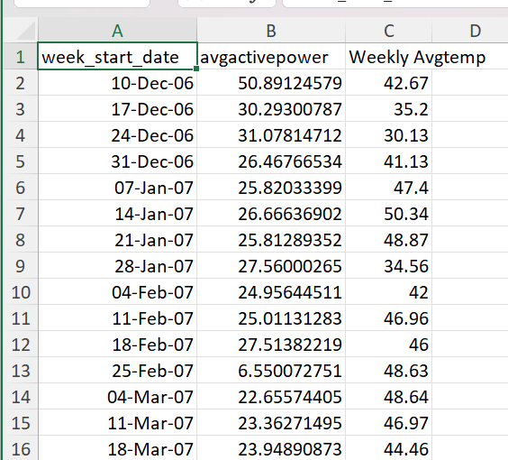
DATA PREPROCESSING
Dataset used: Individual household electric power consumption
Using data from the UCI Machine Learning repository.
Date, Time, Global_active_power, Sub_metering_1, Sub_metering_2, Sub_metering_3
The average active power was calculated using the formula (global_active_power*1000/60)
Incorporated historical weather data from Wunderground.
Calculated the weekly average temperatures.
Data is from 10 Dec 2006 to 21 Nov 2010
4

Slide 5
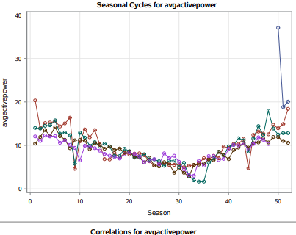
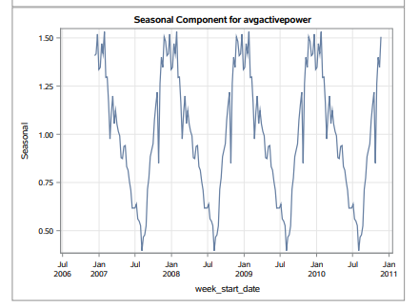
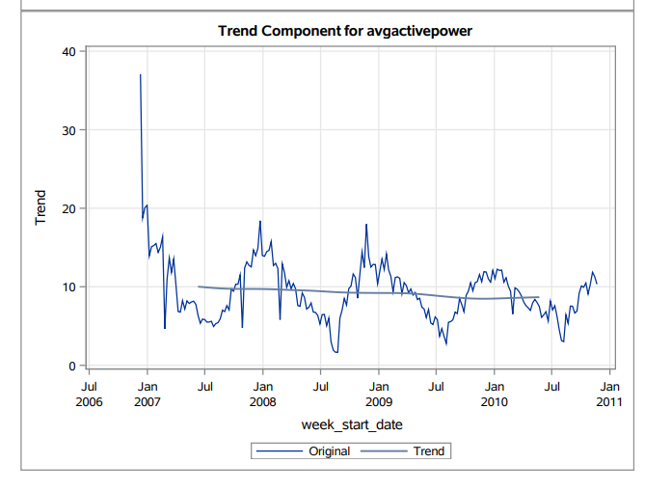
TIME SERIES DECOMPOSITION

Slide 6
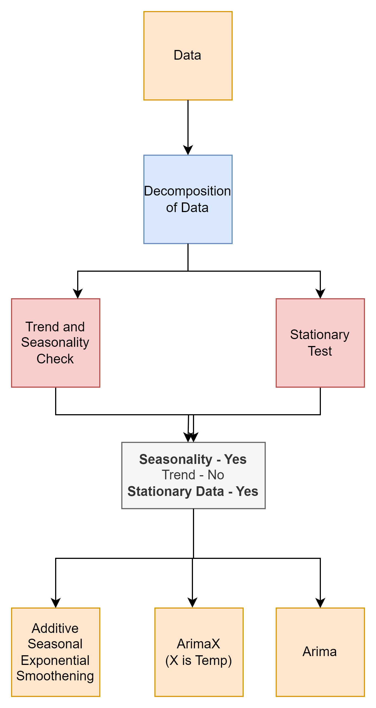
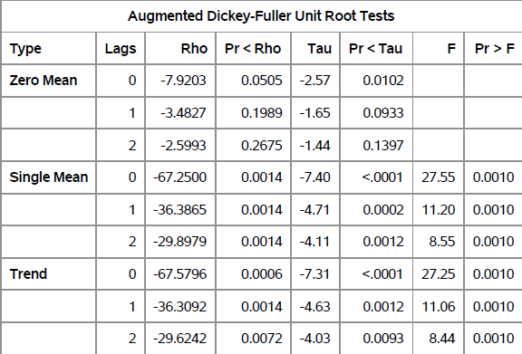
MODELING APPROACH
No trend observed
Stable seasonality seen
We can conclude dataset is stationary
Notes:
Dicki fuller

Slide 7
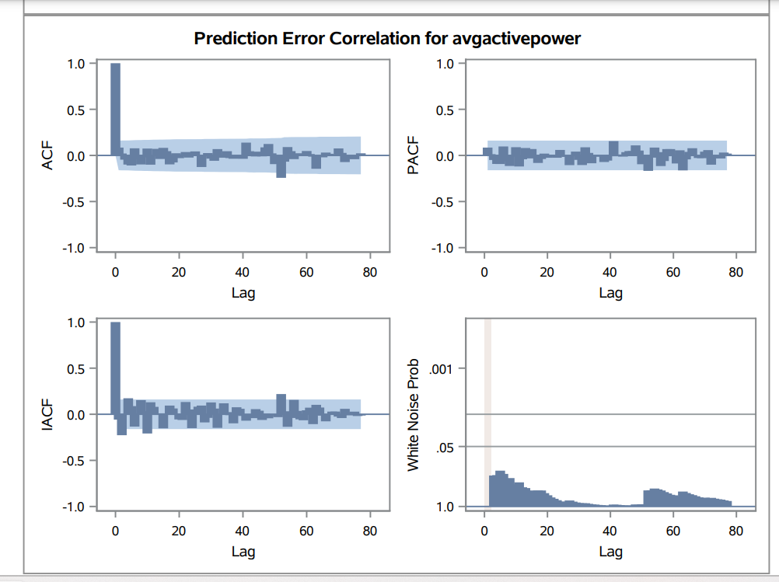
ADDITIVE SEASONAL MODELLING
Residuals present is the white noise.
No component to model
Additive Seasonal Modelling
AIC | SBC
347.35 | 353.44

Slide 8
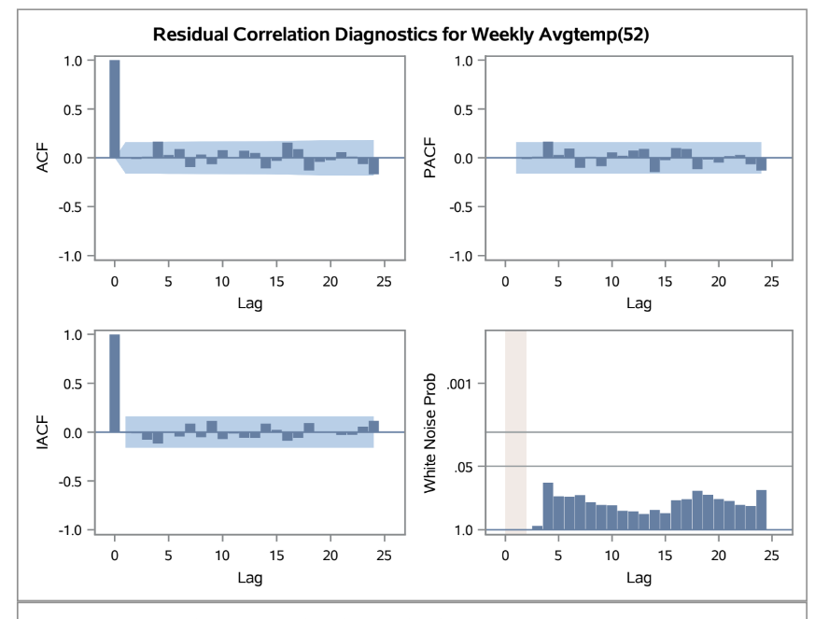
SEASONAL ARIMAX
Pre-Whitening
SARIMA(1,0,1)'s White noise Probability test shows residuals distributed as white noise.
MODEL | Seasonal Diff | AIC | SBC
ARIMA(0,0,1) | 1 | 952.38 | 958.46
ARIMA(1,0,0) | 1 | 952.33 | 958.42
ARIMA(1,0,1) | 1 | 951.16 | 960.29
ARIMA(1,0,2) | 1 | 951.86 | 964.03
ARIMA(2,0,1) | 1 | 953.16 | 965.33
ARIMA(2,0,2) | 1 | 951.43 | 966.65
8

Slide 9
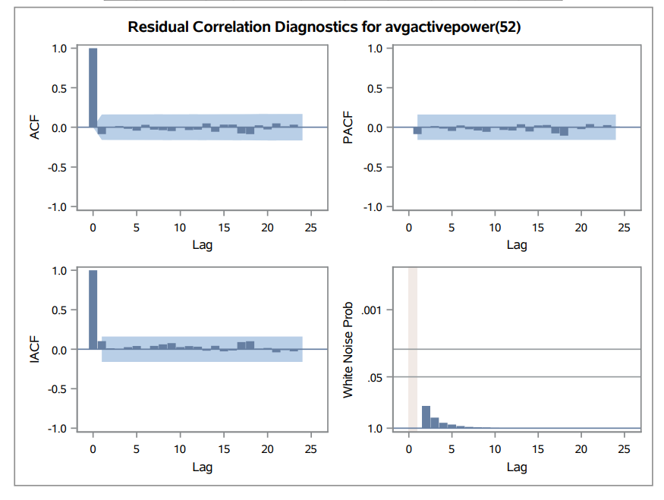
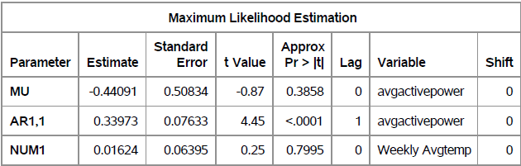
SEASONAL ARIMAX
Model Results
ARIMAX(1,0,1) is the best model
Residual is white Noise
No evidence of dependency across the first 24 lags
No Mathematical significance for NUM1.
Thus, moved on to seasonal ARIMA without the x-factor
MODEL | Seasonal Diff | AIC | SBC
ARIMA(0,0,1) | 1 | 886.45 | 895.58
ARIMA(1,0,0) | 1 | 884.68 | 893.81
ARIMA(1,0,1) | 1 | 886.63 | 898.81

Slide 10
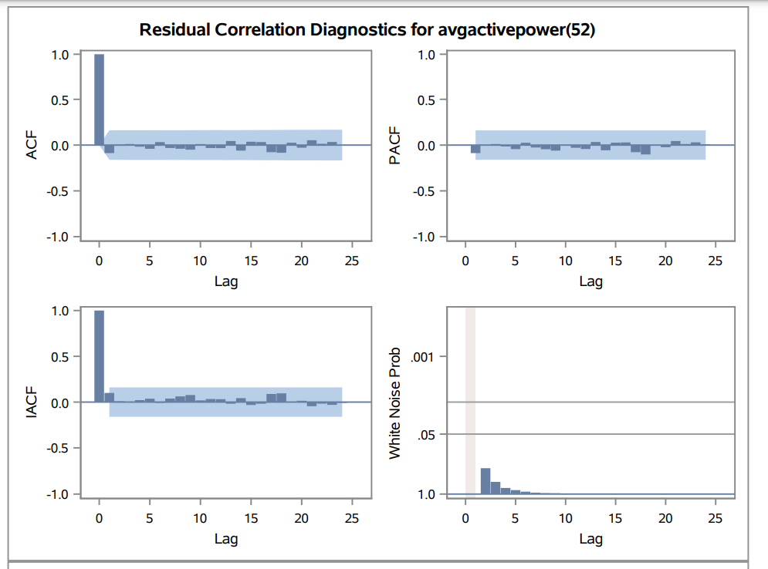
SEASONAL ARIMA
Model Results
ARIMA(1,0,0) is the best model
Residual is white Noise
No evidence of dependency across the first 24 lags
MODEL | Seasonal Diff | AIC | SBC
ARIMA(0,0,1) | 1 | 884.52 | 890.61
ARIMA(1,0,0) | 1 | 882.75 | 888.84
ARIMA(1,0,1) | 1 | 884.70 | 893.83

Slide 11
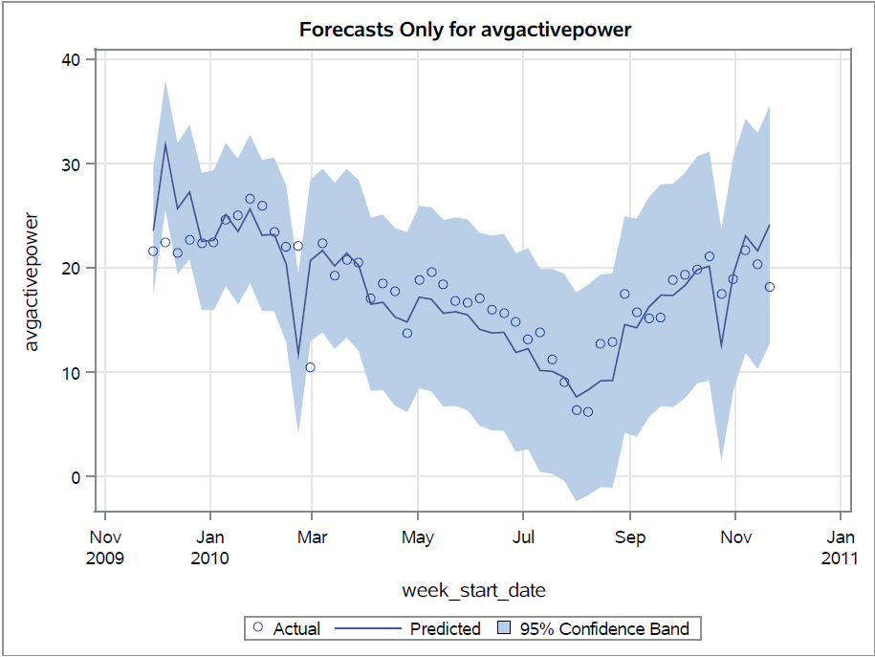
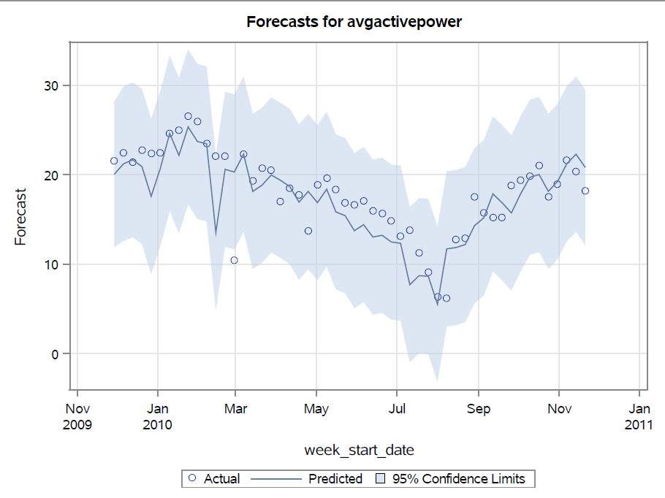
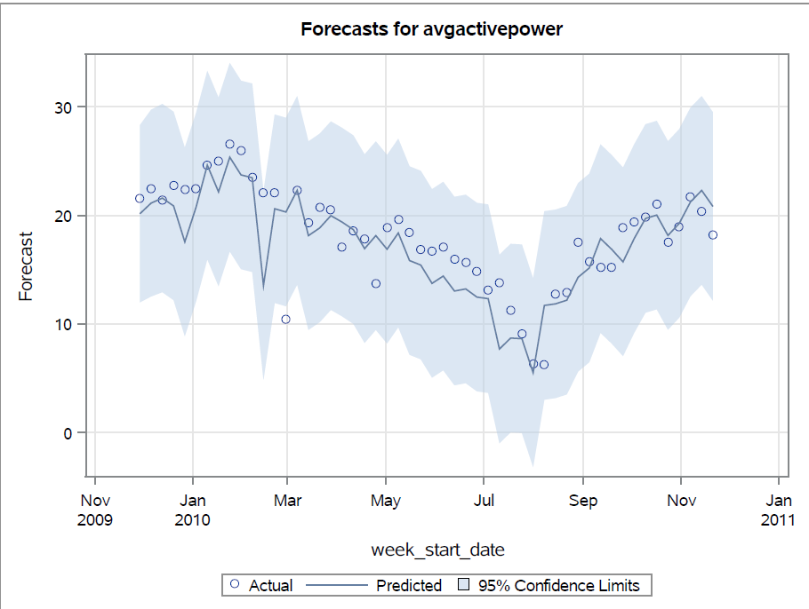
MODEL COMPARISON AND ACCURACY
In conclusion, ARIMA(1,0,0) is showcasing high performance
The following are holdout sample forecast results
ADDITIVE
MAPE: 14.00
RMSE: 3.24
ARIMAX
MAPE: 13.62
RMSE: 1.80
ARIMA
MAPE: 13.62
RMSE: 1.34

Slide 12
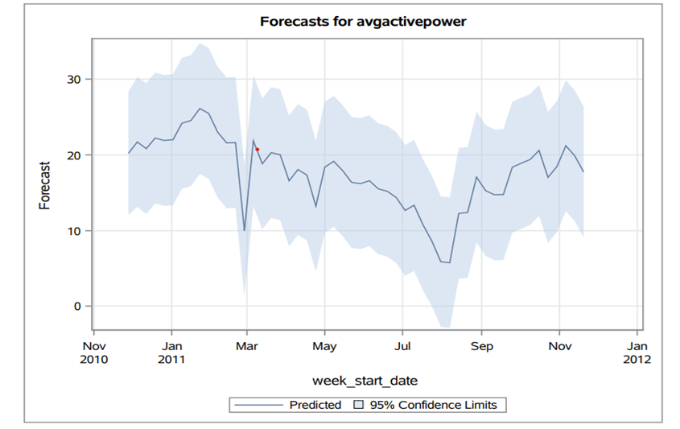

MODEL SELECTION

Slide 13
INSIGHTS AND RECOMMENDATIONS
Insights
The model captures the trend and seasonality in historical data, which can aid in understanding demand cycles.
The confidence intervals suggest varying levels of uncertainty, informing risk assessment for decision-making.
Recommendations
Incorporate ARIMA forecasts in planning to manage inventory, staffing, and budgeting more effectively.
Monitor the model's performance over time and update it as more data becomes available to maintain accuracy.

Slide 14

Any Questions ?

